Slide 1
Minimize risk of investing in technology stocks
Team 5
Tan Jun Hong
Shao Yakun
Ian Pang Yi En
Chin Min Ray
Ryan Tan Yu Xiang
Sherwin Lui Jia Xing
Notes:
Technology stocks has been one of the most popular sector that has attracted many investors and asset managers, yet, it is notorious for being highly volatile, therefore making it a risky investment option. In such

Slide 2
TABLE OF CONTENTS
1
2
INTRODUCTION
SOLUTION 1
3
4
SOLUTION 2
BUSINESS IMPLEMENTATION
Notes:
I will be doing an introduction to the problem statement and our approach, and my teammates will continue to further explain our solutins and business implementation of

Slide 3
INTRODUCTION
Yakun
Technology stocks are high-risk, high-return. How do we better identify and minimise risk for investors who wish to invest in technology stocks and enjoy a greater investment return?

Slide 4
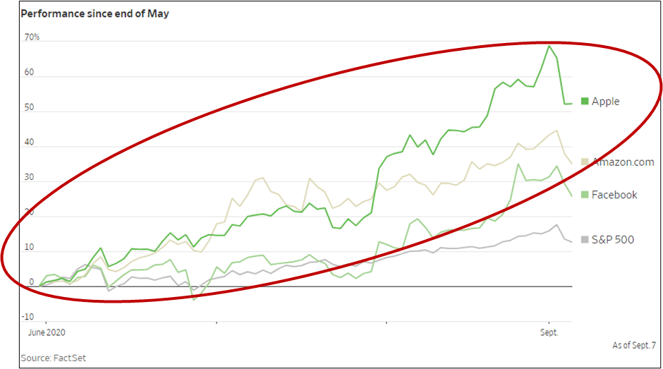
Introduction
Yakun
Notes:
https://pdfs.semanticscholar.org/e27e/bd57dc467ecb3507f399df9becda8de93e0b.pdf

Slide 5
INTRODUCTION
CURRENT INVESTMENT DECISION-MAKING PROCESS
PROBLEM IDENTIFIED
OUR APPROACH
Yakun
Overview of current investment decision-making process
Insufficiencies of the current current practices adopted
To adopt a data-driven approach using data analytics tools
Notes:
We will first, take a look at the current decision making process adopted by most asset management firms including white rock, and identify the problem and insufficiencies of the current practices, and give a brief overview of our solution approach to the problem identified

Slide 6
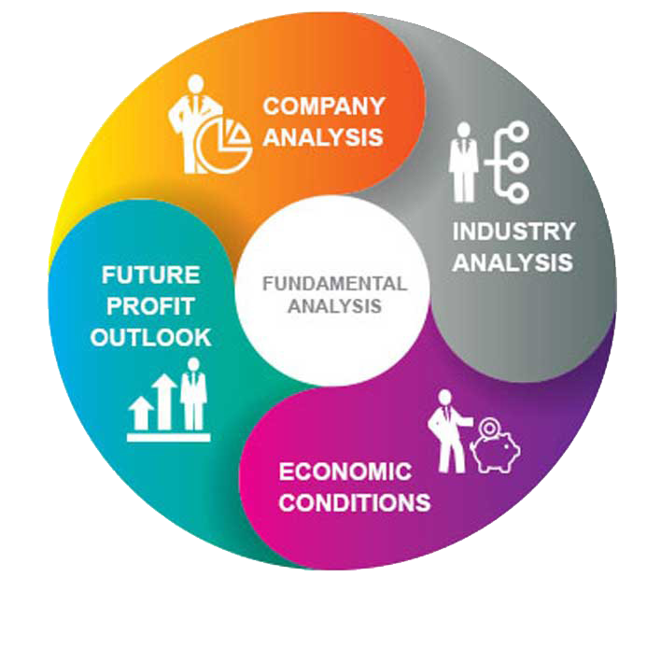
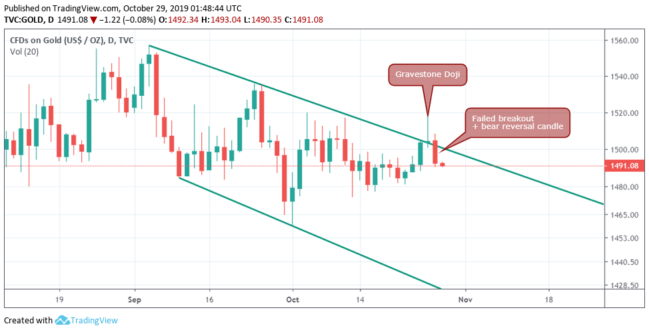
Investment Decision-Making Process
Yakun
Fundamental Analysis
Technical Analysis
Moving Averages
Charts & patterns
Models & statistics
Notes:
When it comes to the investment in equities, there are two distinctive framework that most investors has adopted.
Fundamental analysis, and technical analysis

Slide 7
Investment Decision-Making Process
Yakun
Fundamental Analysis

Slide 8

Current Investment Decision-Making Process
Yakun
Select a potential stock
Calculate Ratios/ Financial Statement Analysis
Invest

Slide 9

Current Investment Decision-Making Process
Yakun
Calculate Ratios/ Financial Statement Analysis
Select a potential stock
Invest
Generally takes long time

Slide 10
Current Investment Decision-Making Process
Yakun
Select a potential stock
Calculate Ratios/ Financial Statement Analysis
Invest
Generally takes long time

Slide 11
Problem Identified
Yakun
1
Inaccuracy and inefficiency in predictions due to the high-volatility nature of technology stocks

Slide 12
Problem Identified
Yakun
1
Inaccuracy and inefficiency in predictions due to the high-volatility nature of technology stocks
2
The need to evaluate external stock market trends

Slide 13
Problem Identified
Yakun
How can we enable asset managers to make more timely and more accurate decisions when investing in technology stocks (so as to minimize risk)?

Slide 14
Problem Identified
Yakun
1
Inaccuracy and inefficiency in predictions due to the high-volatility nature of technology stocks
2
The need to evaluate external stock market trends

Slide 15
Our Approach
Yakun
1
Inaccuracy and inefficiency in predictions due to the high-volatility nature of technology stocks
More accurate and timely prediction on the change in stock prices based on key financial metrics
2
The need to evaluate external stock market trends

Slide 16
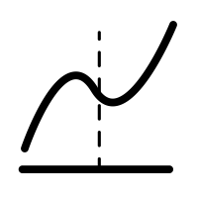

Our Approach
Yakun
1
More accurate and timely prediction on the change in stock prices based on key financial metrics
Logistic Regression
CART
2
The need to evaluate external stock market trends

Slide 17
Our Approach
Yakun
1
More accurate and timely prediction on the change in stock prices based on key financial metrics
Logistic Regression
CART
2
The need to evaluate external stock market trends
To statistically predict the future trends of stock prices for a specific stock

Slide 18
Our Approach
Yakun
1
More accurate and timely prediction on the change in stock prices based on key financial metrics
Logistic Regression
CART
2
To statistically predict the future trends of stock prices for a specific stock
Autoregressive Integrated Moving Average (ARIMA)

Slide 19
2. SOLUTION 1
Yakun
Utilisation of Logistic Regression and CART on our selected dataset to determine the profitability of future technology stock performance.

Slide 20
2. SOLUTION 1
OVERVIEW
ANALYSIS
DATA CLEANING
DATA EXPLORATION
CART & LOGISTIC REGRESSION
Yakun

Slide 21


2. SOLUTION 1 (Overview)
Min Ray
Dataset of 4000+ US companies Financial Indicators
Profitability Ratio Profit Margin EBITDA Margin Enterprise Value over EBITDA Return on Equity | Leverage Ratio Debt to Equity Ratio Interest Coverage
Liquidity Ratio Free Cash Flow Yield Current Ratio Operating Cash Flow to Sales Ratio | Efficiency Ratio Asset Turnover Ratio
Market Prospect Ratio PE ratio PB ratio EPS Diluted Growth | Revenue growth Book Value per share Dividend Yield
Others Market Capitalisation
Trimmed down to 21 columns from 200+ Mainly, 6 categories, Price variance and class.
Price variance
difference in stock price
Class
0: -ve price variance
1: +ve price variance

Slide 22


2. SOLUTION 1 (Overview)
Min Ray
Category | Variables | Justification
Profitability Ratio | Profit Margin EBITDA Margin Enterprise Value over EBITDA Return on Equity(ROE) | Profitability ratios are ratios which assess a company’s ability to generate earnings relative to revenue, operating cost. Ratios such as ROE are proven to be effective in predicting the future value of stock price.(Arkan,2016)
Leverage Ratio | Debt to Equity Ratio (D/E Ratio) Interest Coverage | Leverage ratios are ratios which assess the ability of a company to meet its financial obligations, and they are closely related to stock prices. For example, a research report states that there is a significant positive relationship between DE ratio and stock price. (Arkan,2016)
Notes:
https://pdfs.semanticscholar.org/e27e/bd57dc467ecb3507f399df9becda8de93e0b.pdf

Slide 23


2. SOLUTION 1 (Overview)
Min Ray
Category | Variables | Justification
Liquidity Ratio | Free Cash Flow Yield Current Ratio Operating Cash Flow to Sales Ratio | Liquidity ratio measures a company’s ability to pay debt obligations and its margin of safety. Investors would consider if a company has the ability to convert assets into cash.
Efficiency Ratio | Asset Turnover Ratio | Asset Turnover ratio shows how likely a company is able to effectively generate revenue from their assets.

Slide 24

2. SOLUTION 1 (Overview)
Min Ray
Category | Variables | Justification
Market Prospect Ratios | P/E ratio P/B ratio Dividend Yield Book Value per share EPS Diluted Growth Revenue growth | Market prospect ratios provide investors with an estimate of the value they would receive from their investment. Ratios such as PE ratio do in fact have a strong relationship with price of stocks and can be used to forecast market returns. (Mozes, 2017)
Others | Market Capitalisation (Market Cap) | Market capitalisation is the total dollar value of outstanding shares of a company. The greater the market capitalization, the greater interest the investors will have (wan, 2018).
etc.

Slide 25
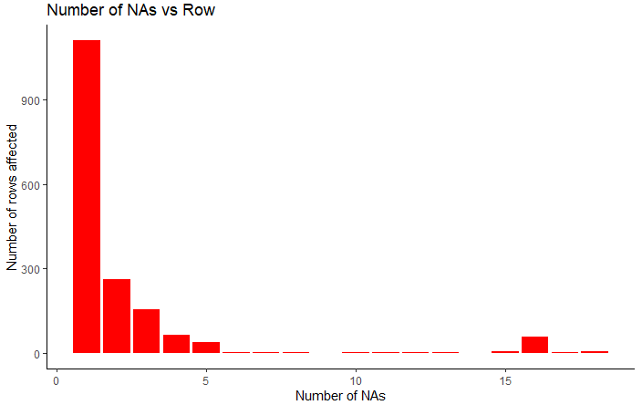
2. SOLUTION 1 (Data Cleaning)
Min Ray
Removed corresponding rows with many NA values
Bar plot of number of ‘NA’ values in each row

Slide 26
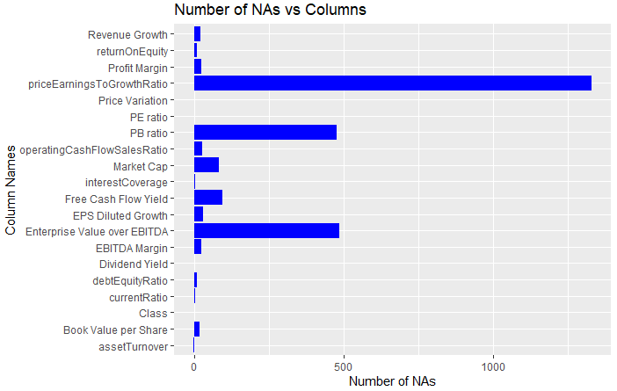
2. SOLUTION 1 (Data Cleaning)
Min Ray
Removed corresponding columns with many NA values
Bar plot of number of ‘NA’ values in each column

Slide 27
2. SOLUTION 1 (Data Cleaning)
Min Ray
Removed values | Reason
Illogical data | Within the data set, there are 3 rows with a market capitalization of 0 but they have an EPS of > 40. All the 3 rows have the same ticker which implies that there might be some error when the data was being keyed in.
Extreme values | To ensure that extreme values do not skew the accuracy of our models, we have done a boxplot for each of the 18 remaining variables to identify and remove such values from our dataset. In total, we have identified 31 rows to be removed from the dataset.

Slide 28
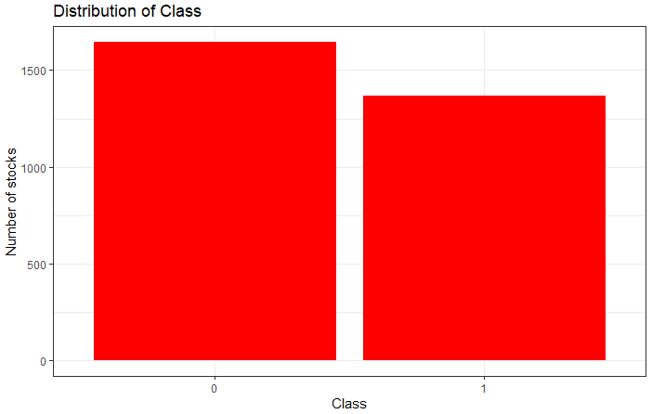
2. SOLUTION 1 (Data Exploration)
Ryan
Distribution of ‘Class’
Bar plot for distribution of ‘Class’

Slide 29
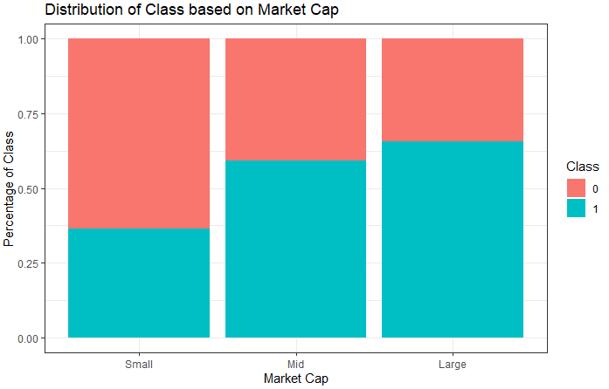
2. SOLUTION 1 (Data Exploration)
Ryan
Distribution of ‘Class’ based on ‘Market Capitalization’
Bar plot for distribution of ‘Class’ based on ‘Market Capitalization’

Slide 30
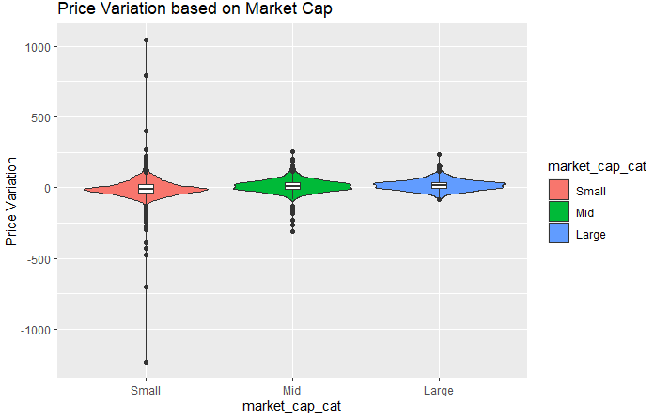
2. SOLUTION 1 (Data Exploration)
Ryan
Distribution of ‘Price Variation’ based on ‘Market Capitalization’
Violin plot for distribution of ‘Price Variation’ based on ‘Market Capitalization’

Slide 31
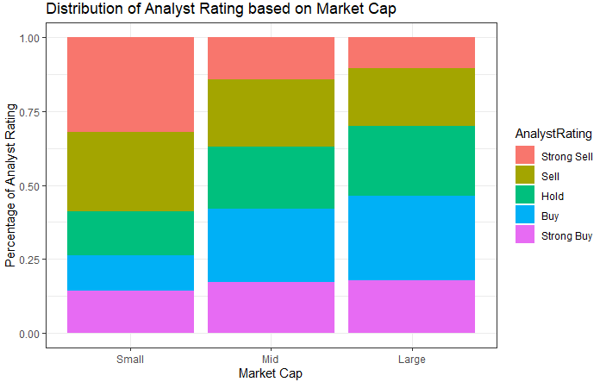
2. SOLUTION 1 (Data Exploration)
Ryan
Distribution of ‘Analyst Rating’ based on ‘Market Capitalization’
Bar plot for distribution of ‘Analyst Rating’ based on ‘Market Capitalization’

Slide 32
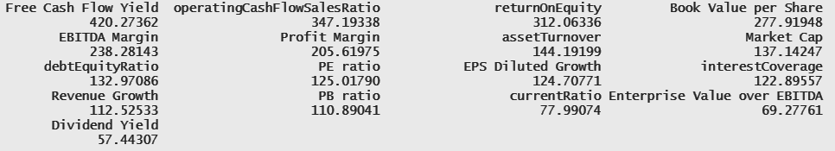
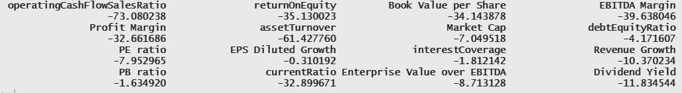
2. SOLUTION 1 (CART)
Ryan
Identify most important variable via variable importance after doing an initial CART model

Slide 33
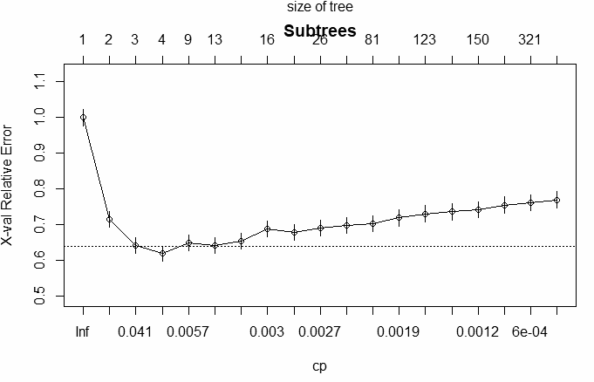
2. SOLUTION 1 (CART)
Ryan

Slide 34
2. SOLUTION 1 (CART)
Ryan
Input Variables | Test Set Accuracy (3dp)
`Free Cash Flow Yield`+ `operatingCashFlowSalesRatio` +`returnOnEquity` + `Book Value per Share` | 68.771%
`Free Cash Flow Yield`+ `operatingCashFlowSalesRatio` +`returnOnEquity` + `Book Value per Share` + `EBITDA Margin` + `Profit Margin` | 68.771%
`Free Cash Flow Yield`+ `operatingCashFlowSalesRatio` +`returnOnEquity` + `Book Value per Share` + `EBITDA Margin` + `Profit Margin` + `assetTurnover` + `Market Cap` + `debtEquityRatio` + `PE ratio` + `EPS Diluted Growth` + `interestCoverage` + `Revenue Growth` + `PB ratio` | 69.657%

Slide 35
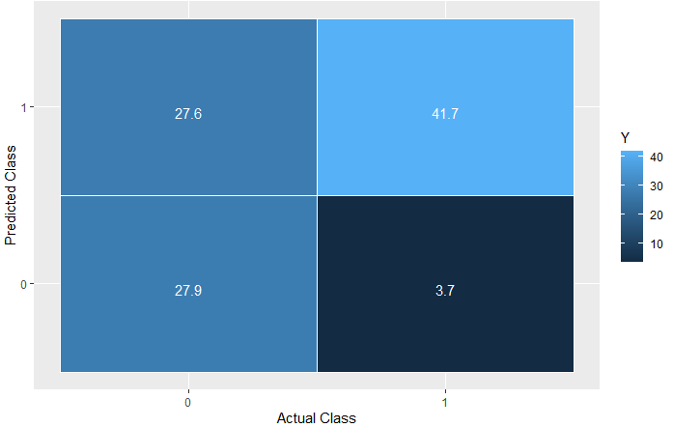
2. SOLUTION 1 (CART)
Ryan

Slide 36
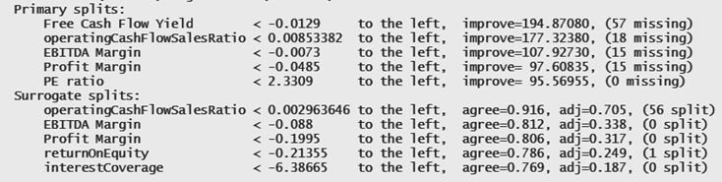
2. SOLUTION 1 (CART)
Ryan

Slide 37

2. SOLUTION 1 (Logistic Regression)
Ian
Remove all rows that contain NA values
NA
NA
NA

Slide 38
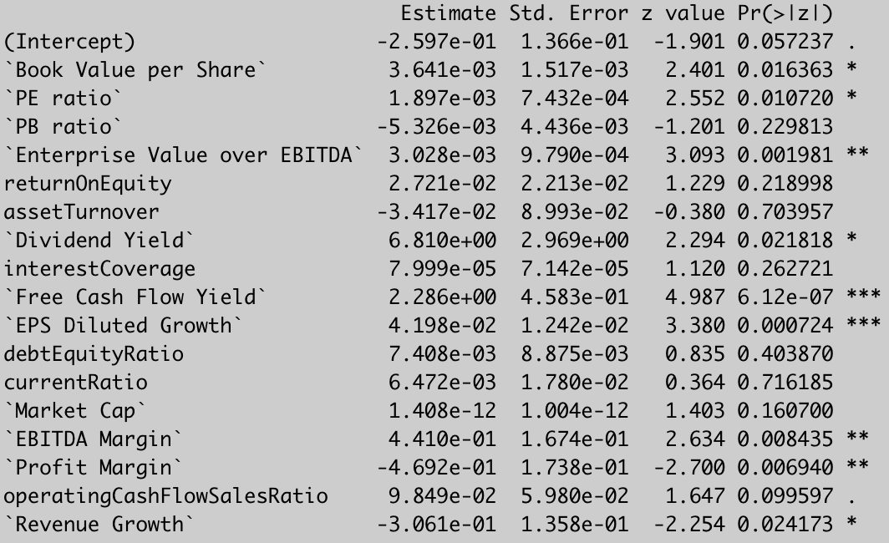
2. SOLUTION 1 (Logistic Regression)
Ian
Initial logistic regression model

Slide 39
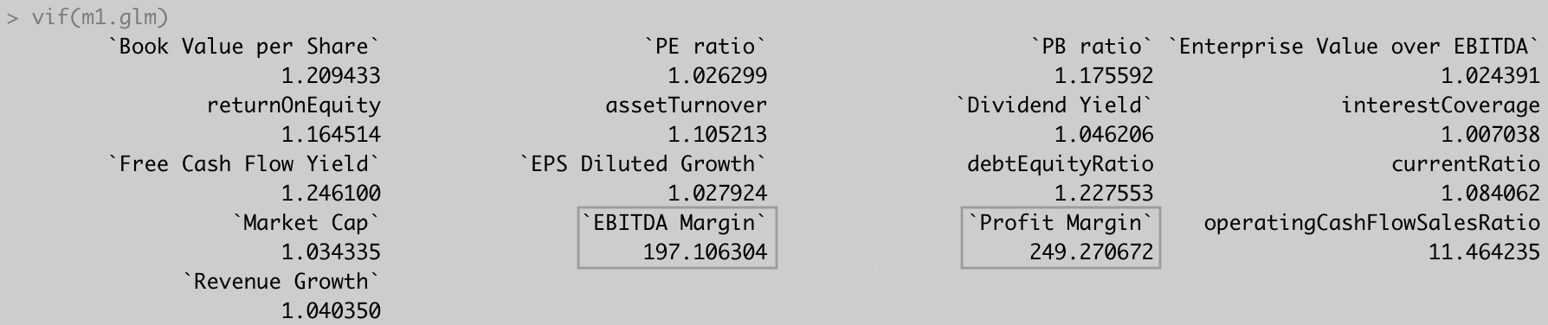
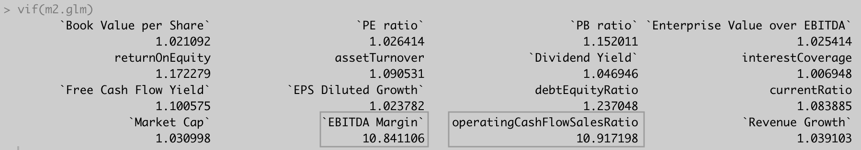
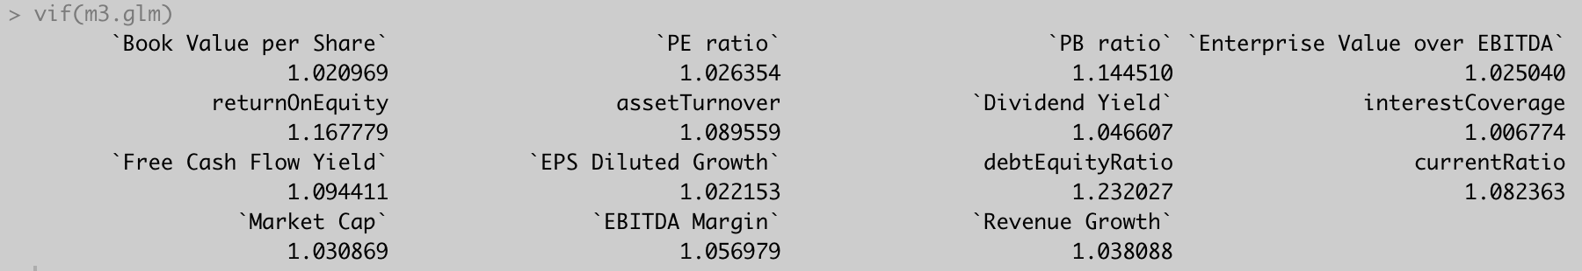
2. SOLUTION 1 (Logistic Regression)
Ian
Check for multicollinearity using VIF values

Slide 40
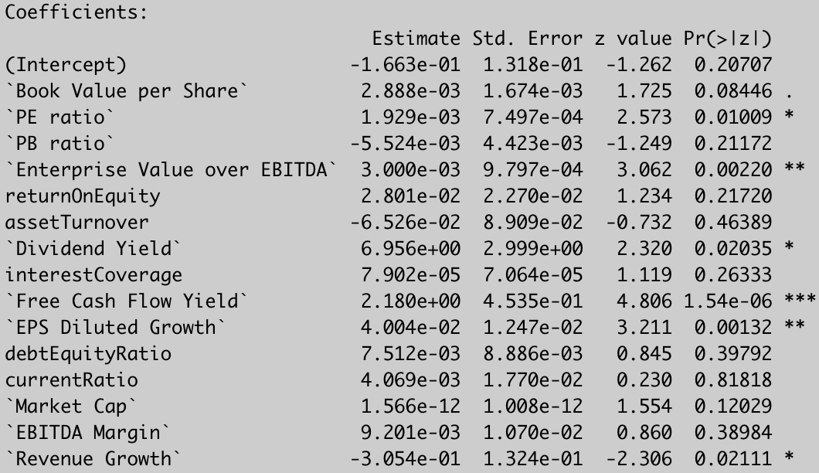
2. SOLUTION 1 (Logistic Regression)
Ian
Logistic regression model after removing multicollinear values

Slide 41
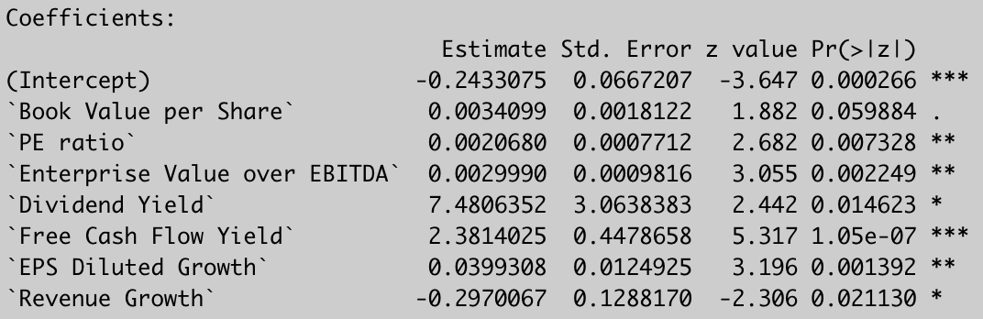
2. SOLUTION 1 (Logistic Regression)
Ian
Final logistic regression model

Slide 42
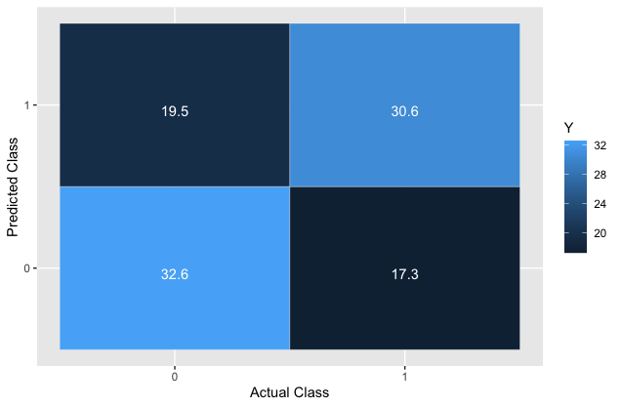
2. SOLUTION 1 (Logistic Regression)
Ian
Confusion matrix for test set
Test set accuracy: 63.2%

Slide 43
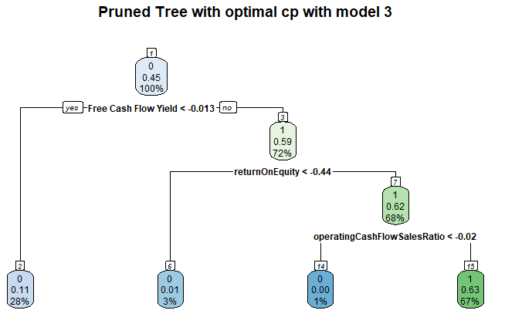
2. SOLUTION 1 (Model Comparison)
Ian
Identified Free Cash Flow Yield as the most statistically significant variable in logistic regression and the most important variable in CART
CART’s prediction accuracy is 6.5% higher than logistic regression’s

Slide 44


2. SOLUTION 1 (Analysis)
Ian
Top 3 factors to take into account:
Free Cash Flow Yield
Operating Cash Flow Sales Ratio
Return on Equity

Slide 45
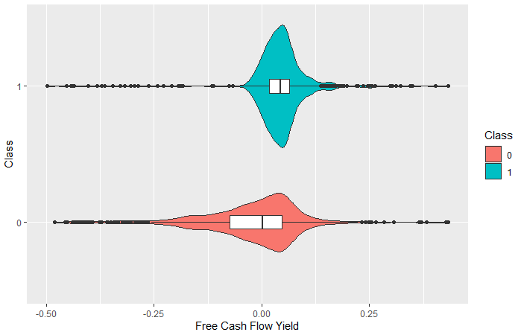
2.1 Free Cash Flow Yield (FCFY)
Ian
> 75% of Tech Stocks classified under 1 has FCFY above 0

Slide 46
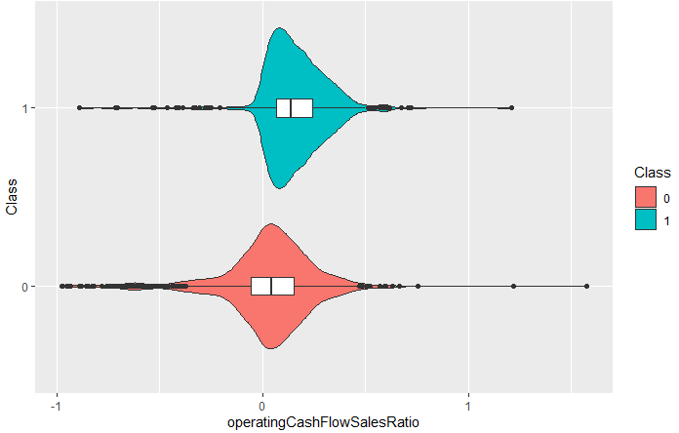
2.2 Operating Cash Flow Sales Ratio (OCFSR)
Ian
> 75% of Tech Stocks classified under 1 has OCFSR above 0.0678

Slide 47
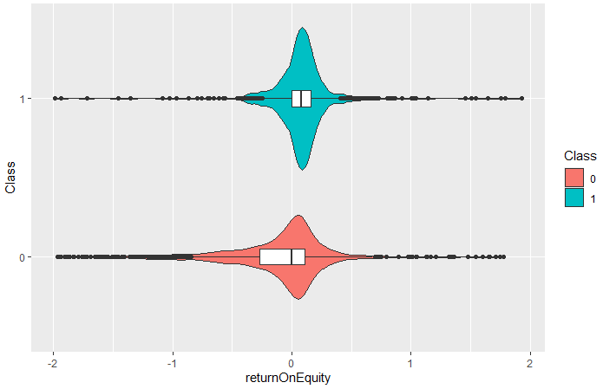
2.3 Return On Equity (ROE)
Ian
Class 1 are highly concentrated as compared to class 0
50% of Class 1 stocks are concentrated slightly above the 0 mark

Slide 48
3. SOLUTION 2
Jun Hong
Utilisation of Auto Regressive Integrated Moving Average (ARIMA) to explore and analyse the volatility of the tech stock market.

Slide 49
3. SOLUTION 2
OVERVIEW
ARIMA
ANALYSIS
DATA CLEANING
DATA EXPLORATION
Jun Hong

Slide 50
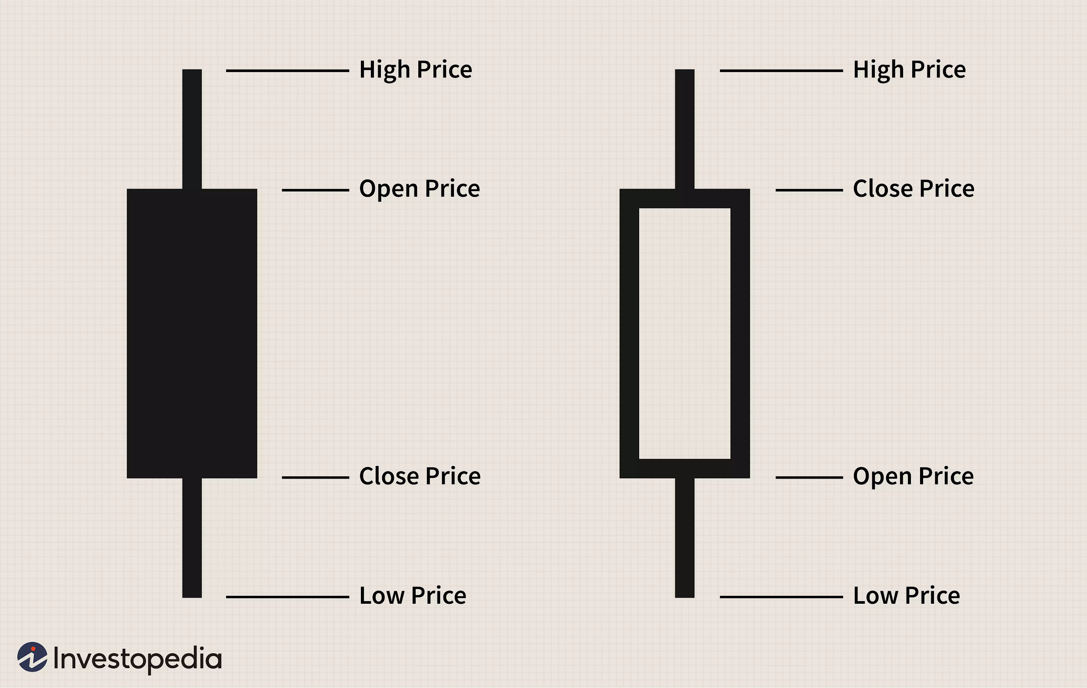
3. SOLUTION 2 (Overview)
Jun Hong
Dataset of Big 5 stocks along with NASDAQ
Consists of daily stock prices from the start of NASDAQ
High
Low
Open
Close
Trade Volume

Slide 51
3. SOLUTION 2 (Data Cleaning)
Jun Hong
No NA Values
Created a column called average, which is average of open, close, high, low
Created another column called moving average, which is the rolling mean of the above column over 121 days
Open | Close | High | Low | Average | Moving Average
Open price | Close price | High price | Low price | (Open + Close + High + Low) / 4 | 4 month average of “average”

Slide 52
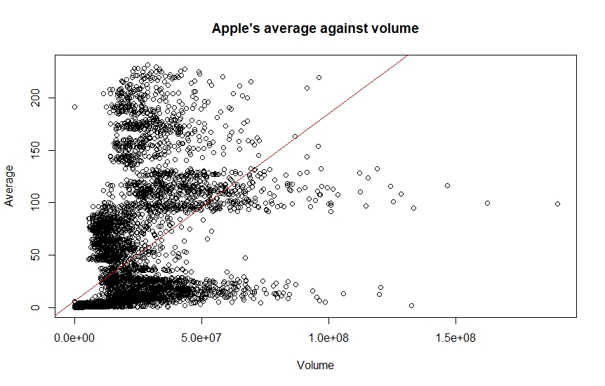
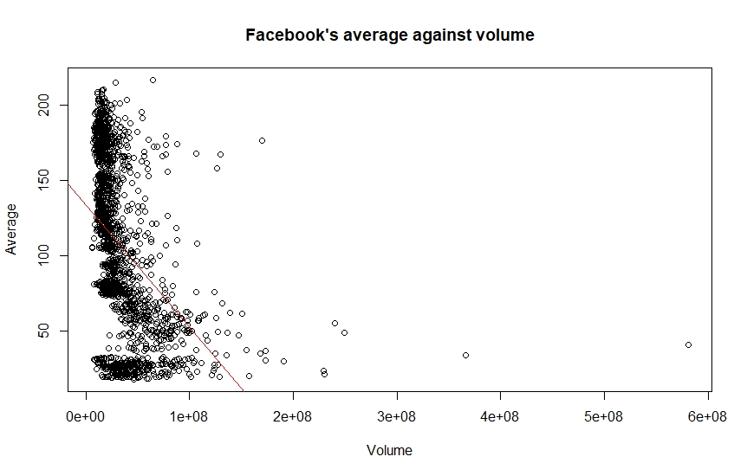
3. SOLUTION 2 (Data Exploration)
Jun Hong

Slide 53
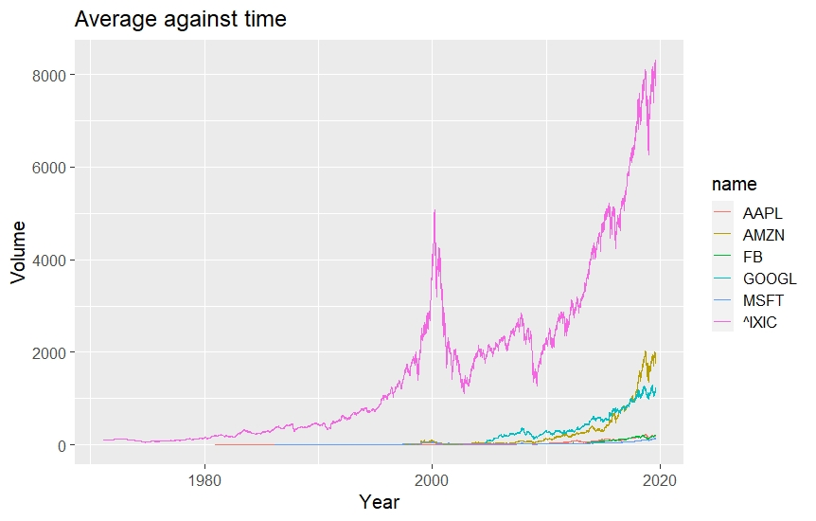
3. SOLUTION 2 (Data Exploration)
Jun Hong

Slide 54
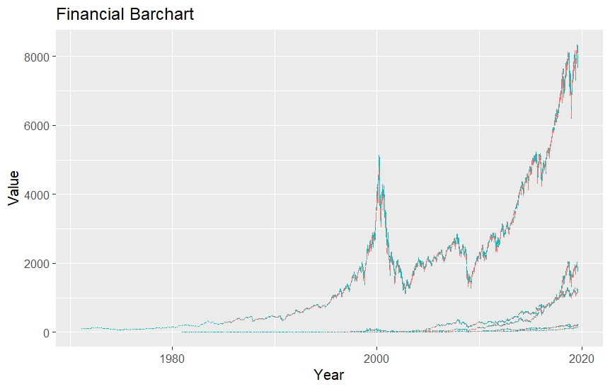
3. SOLUTION 2 (Data Exploration)
Jun Hong

Slide 55
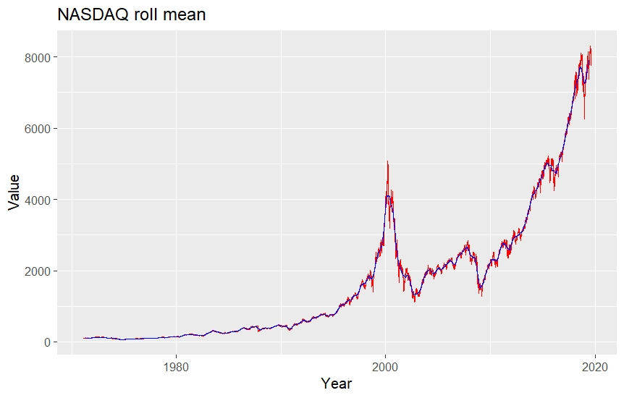
3. SOLUTION 2 (Data Exploration)
Jun Hong

Slide 56
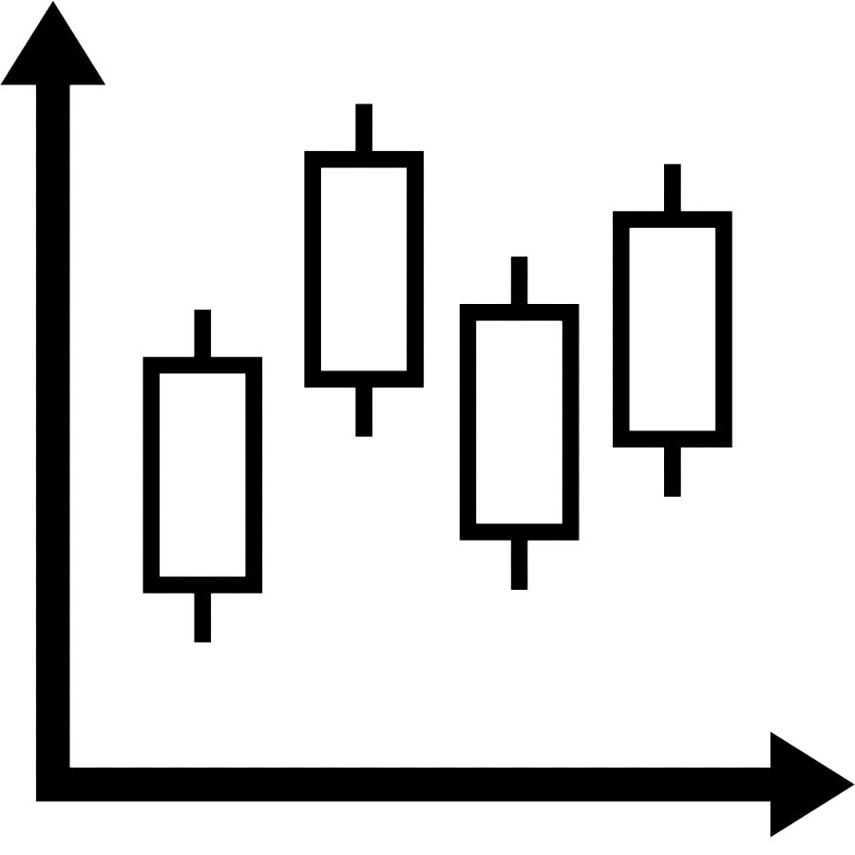

3. SOLUTION 2 (ARIMA)
Jun Hong
Fed rolling mean data to ARIMA
Used it to forecast 2 years worth of data

Slide 57
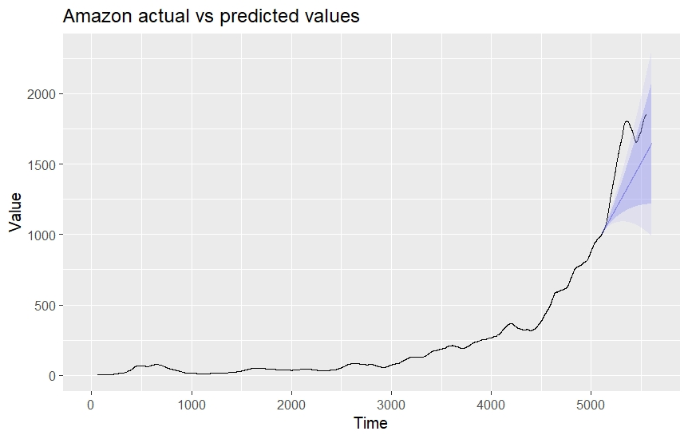
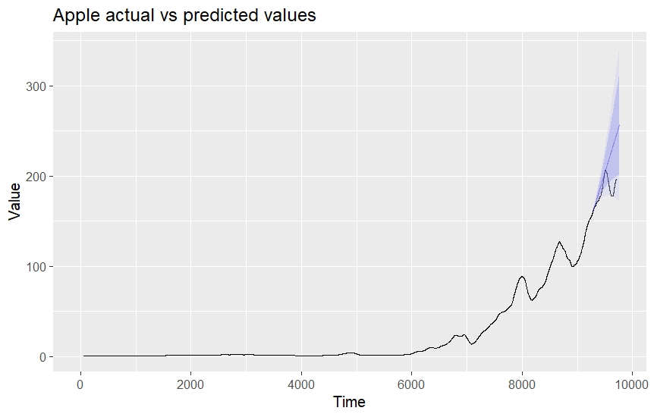
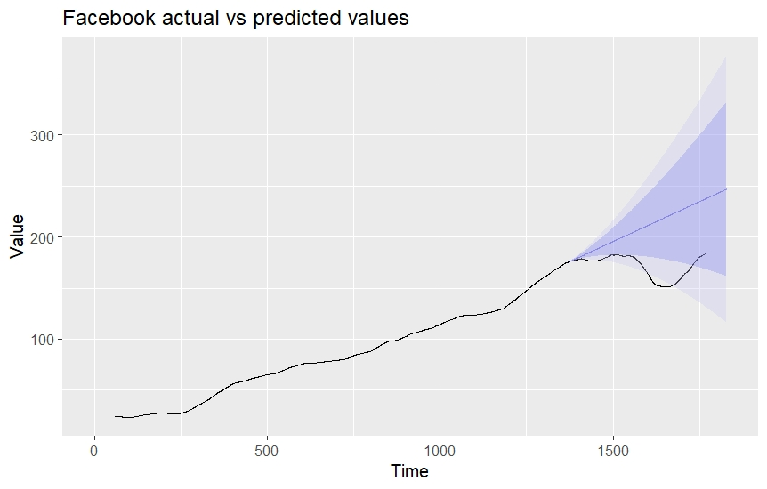
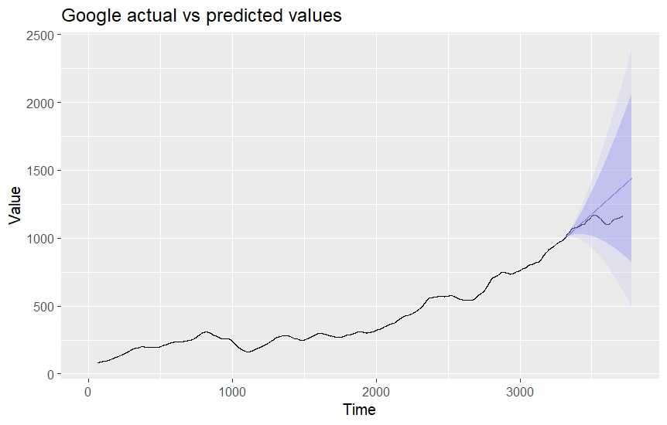
3. SOLUTION 2 (ARIMA)
Jun Hong

Slide 58
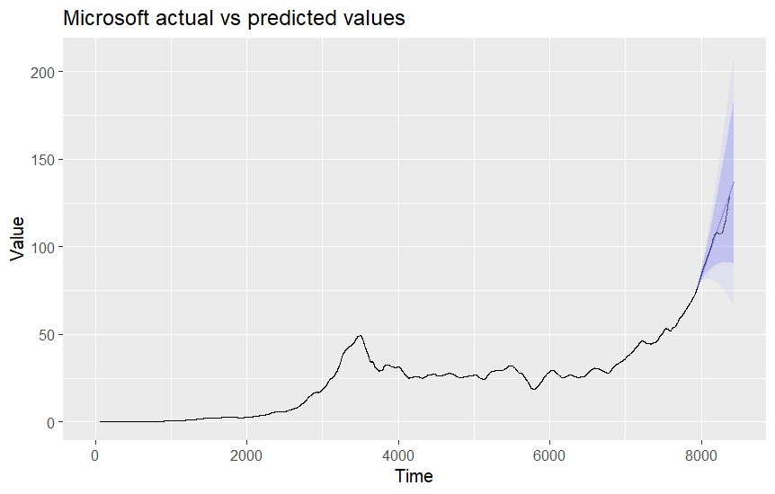
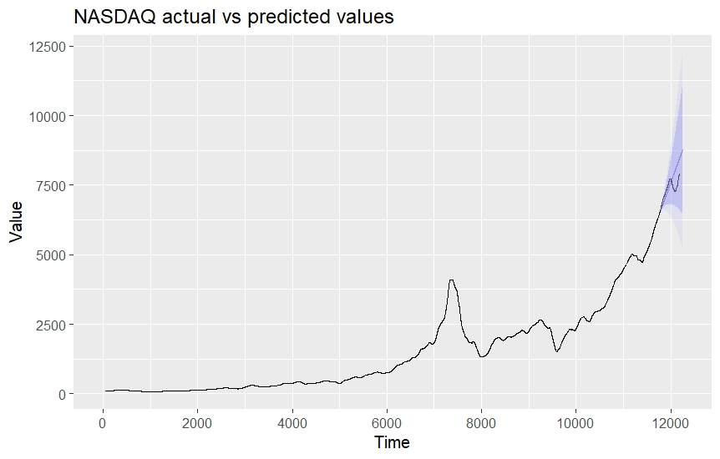
3. SOLUTION 2 (ARIMA)
Jun Hong

Slide 59

3. SOLUTION 2 (Analysis)
Jun Hong
Results look promising
Forecast values closely matches actual values
Actual values within error range
Conclude that model is accurate at predicting prices

Slide 60

3. SOLUTION 2 (Analysis)
Jun Hong
Limitations
Stock price can drop due to other external factors
Facebook 2018 scandals
Tech stocks skyrocketed during the COVID-19 crisis

Slide 61
4. BUSINESS IMPLEMENTATION
Sherwin
What should White Rock do?

Slide 62
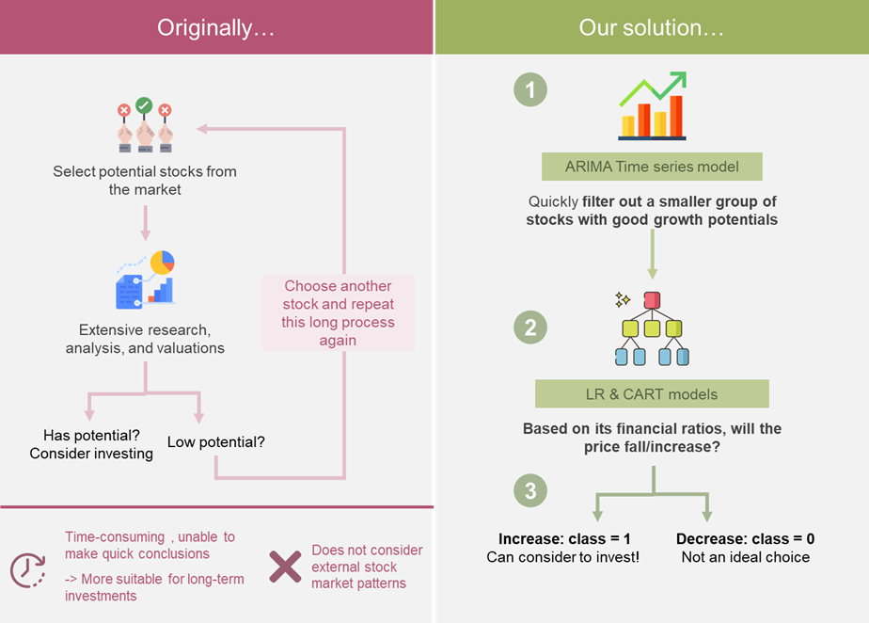
4. Business Implementation
Sherwin

Slide 63
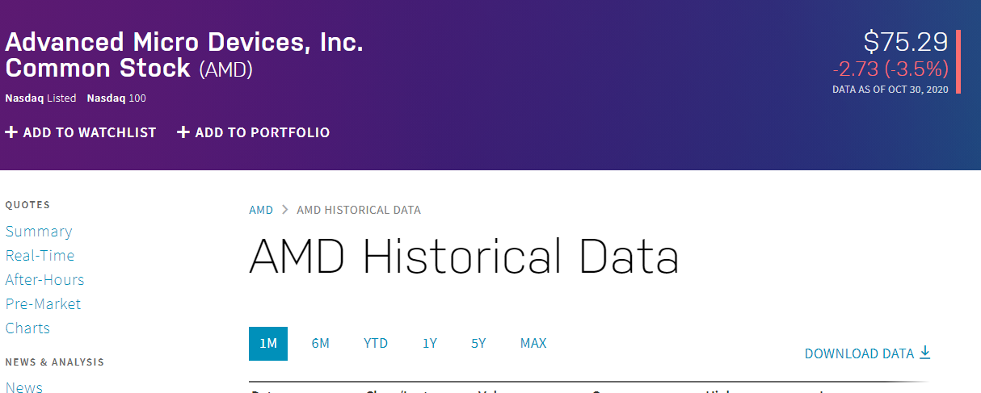

4. Business Implementation
Sherwin
Download AMD Historical Data from NASDAQ
Combine AMD Historical Data with csv file.

Slide 64
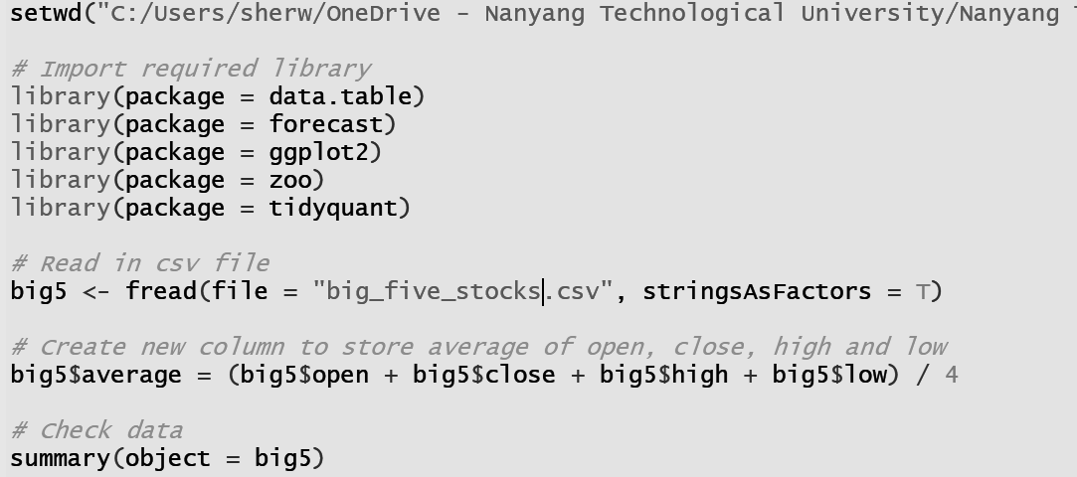
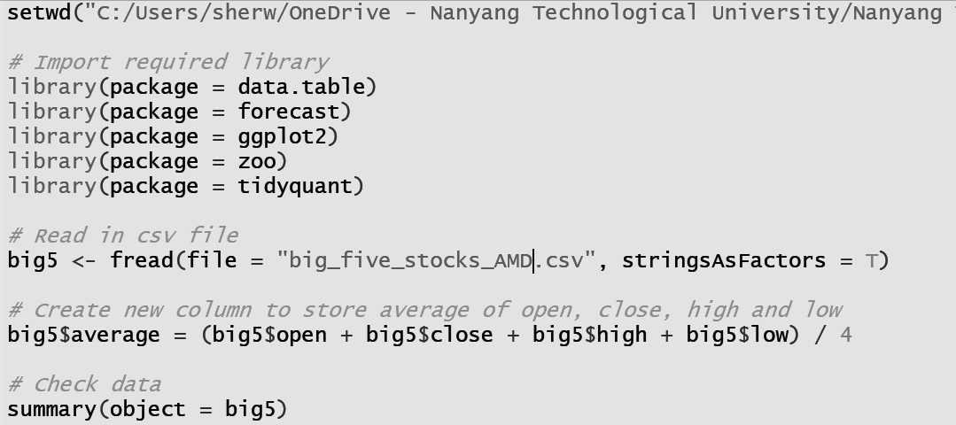
4. Business Implementation
Sherwin

Slide 65
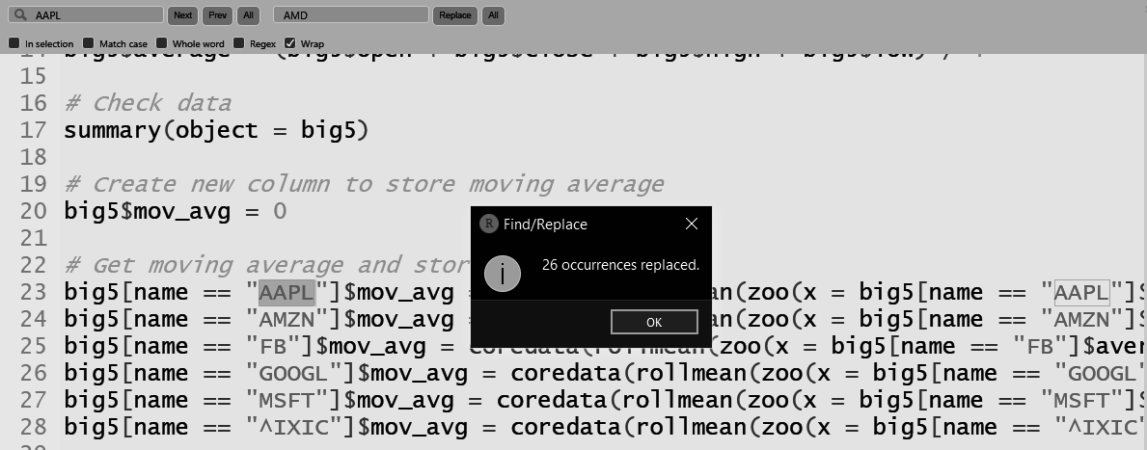
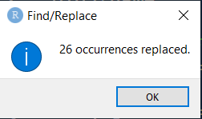
4. Business Implementation
Sherwin

Slide 66
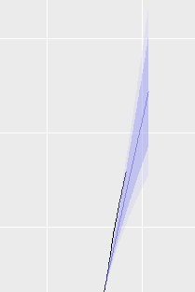
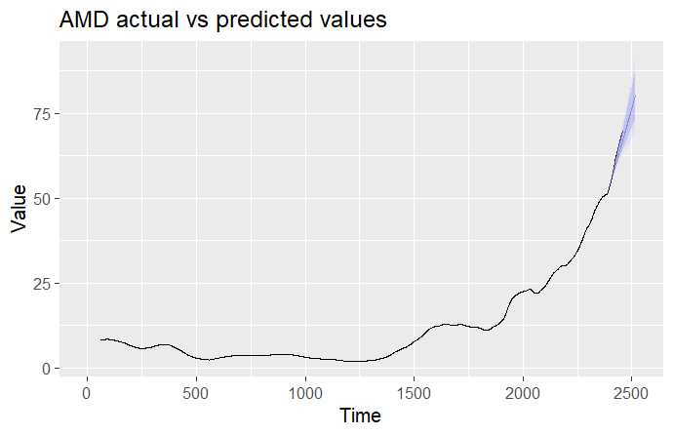
4. Business Implementation
Sherwin

Slide 67
4. Business Implementation
Sherwin
AMD Q3-2020 Financial Reporting
Free cash flow yield | 0.002975
ROE | 0.1165
Operating Cash Flow to Sales Ratio | 0.12

Slide 68
5. FUTURE CONSIDERATION
Sherwin
What can White Rock consider in the future?

Slide 69



5. Future Consideration
Sherwin
Text Mining
Analysing Other Sectors
Algorithmic Trading

Slide 70

5. Future Consideration (Text Mining)
Sherwin
News may affect stock price as well
eg. Wirecard Scandal, Facebook privacy issue
Discussion forums such as InvestingNote, SeekingAlpha may consist of first hand information from investors who has attended AGM
Text mining technologies can be employed to do web scraping

Slide 71

5. Future Consideration
(Analyse Other Sectors)
Sherwin
There is a need to consider the influence of external sectors on the identified sector (technology)
External sector’s supply and demand changes
Machine learning required for the analysis of trends not apparent to the naked eye

Slide 72

5. Future Consideration
(Algorithmic Trading)
Sherwin
Analyse large amounts of data quickly
Automate decision-making process
Use rule-based trades

Slide 73
Thank You!

